Slide 1
Random Forest for KMR-3
Range 1-500

Slide 2
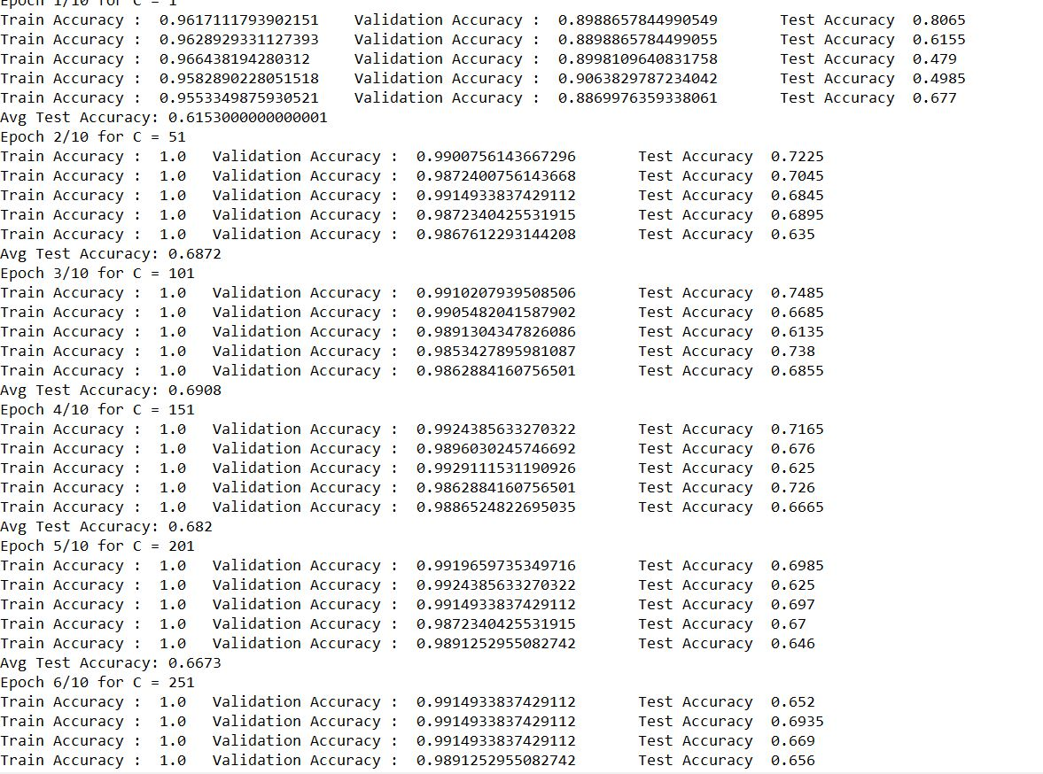

Slide 3
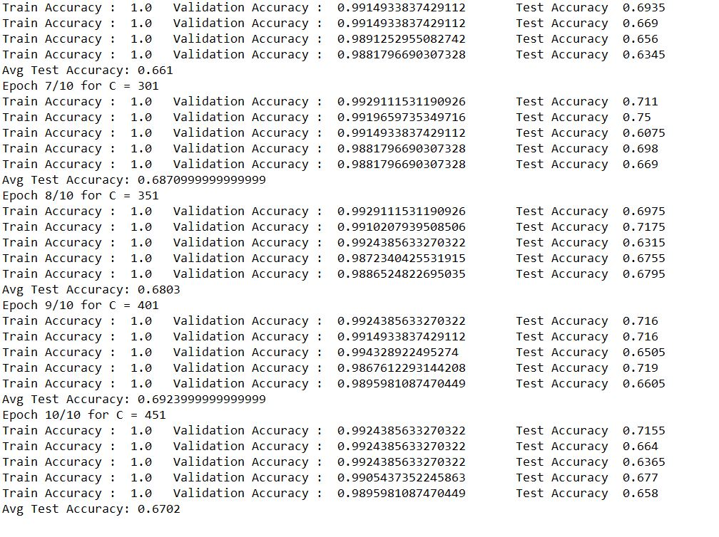

Slide 4
Range 395-405

Slide 5
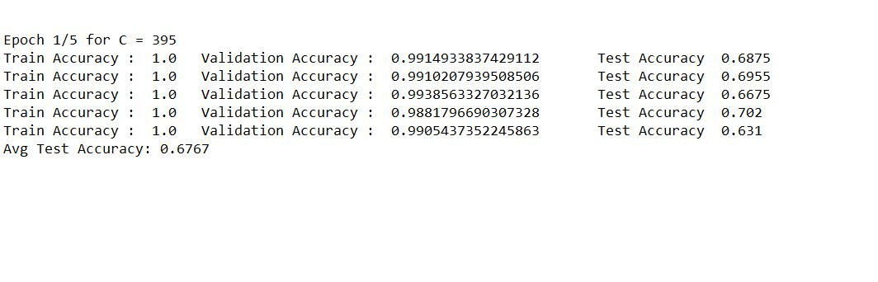

Slide 6
Range -1-101

Slide 7
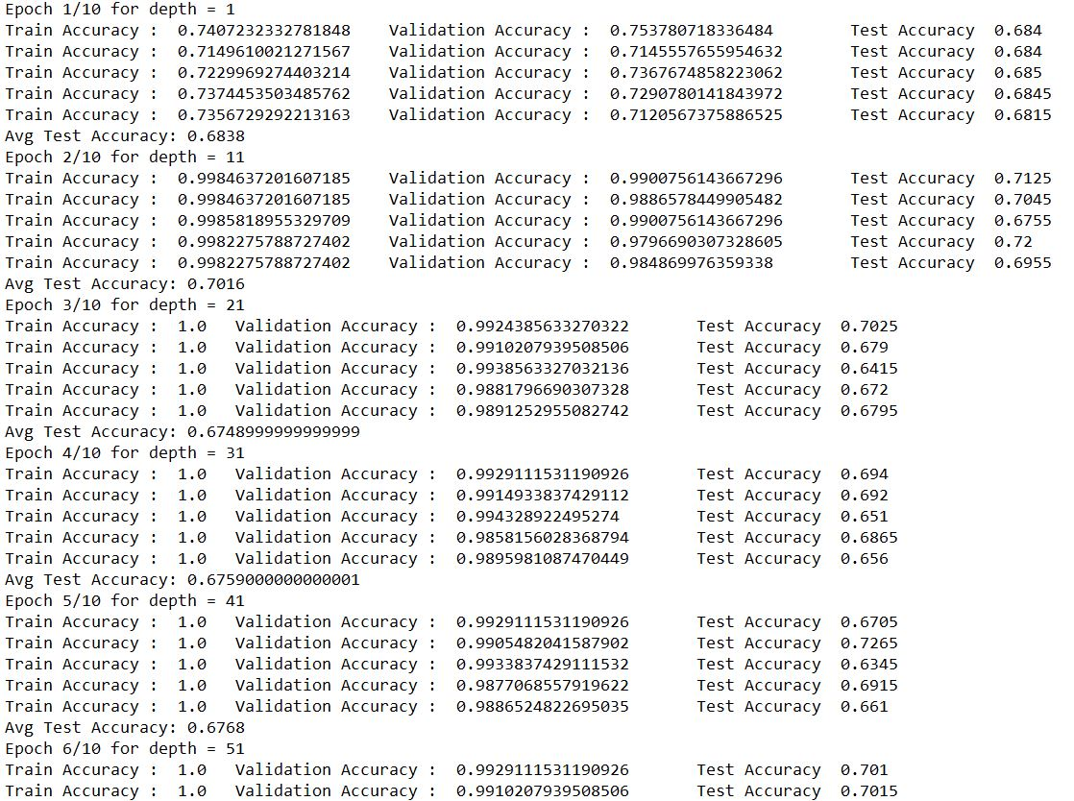

Slide 8
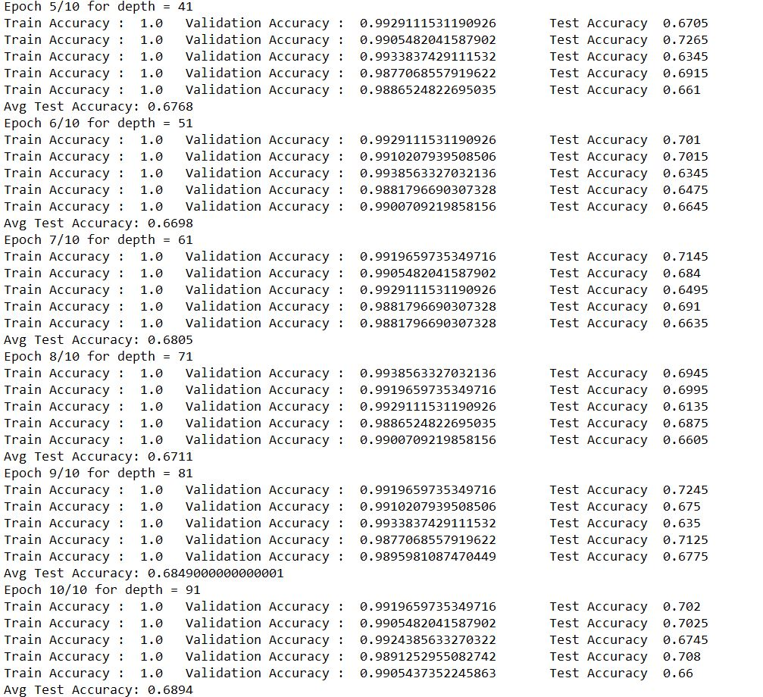

Slide 9
Random Forest for pseKNc
Range 1-500

Slide 10
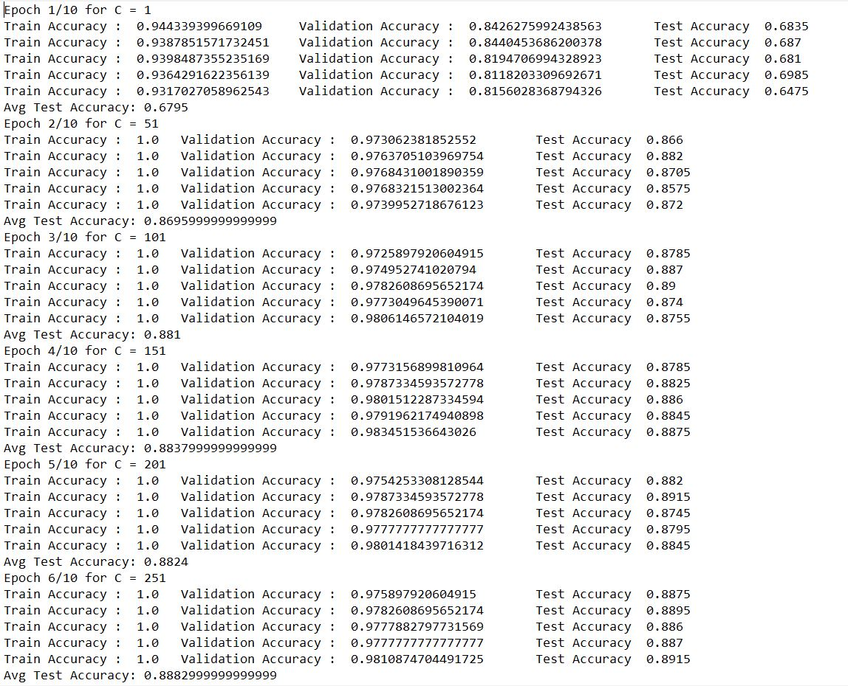

Slide 11
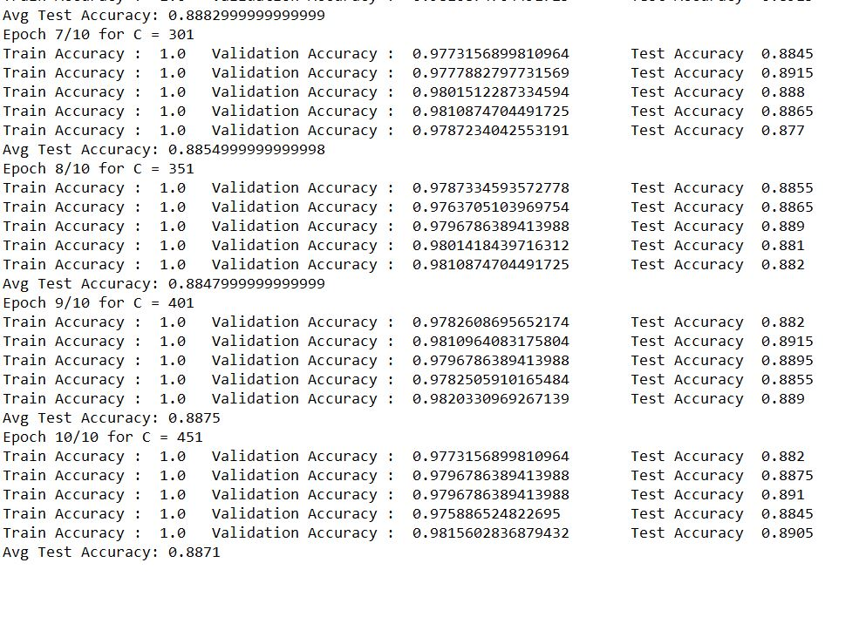

Slide 12
Range 295-305

Slide 13
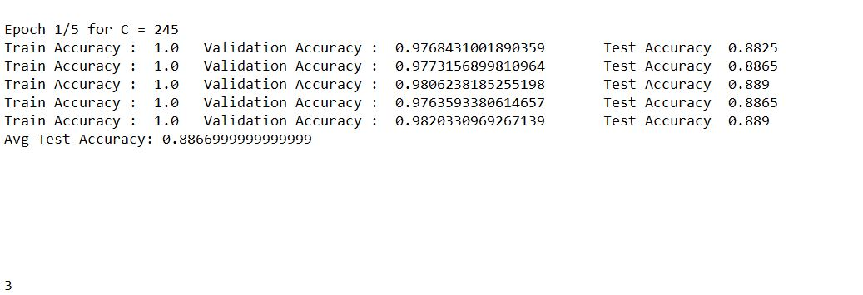

Slide 14
Range 1-101

Slide 15
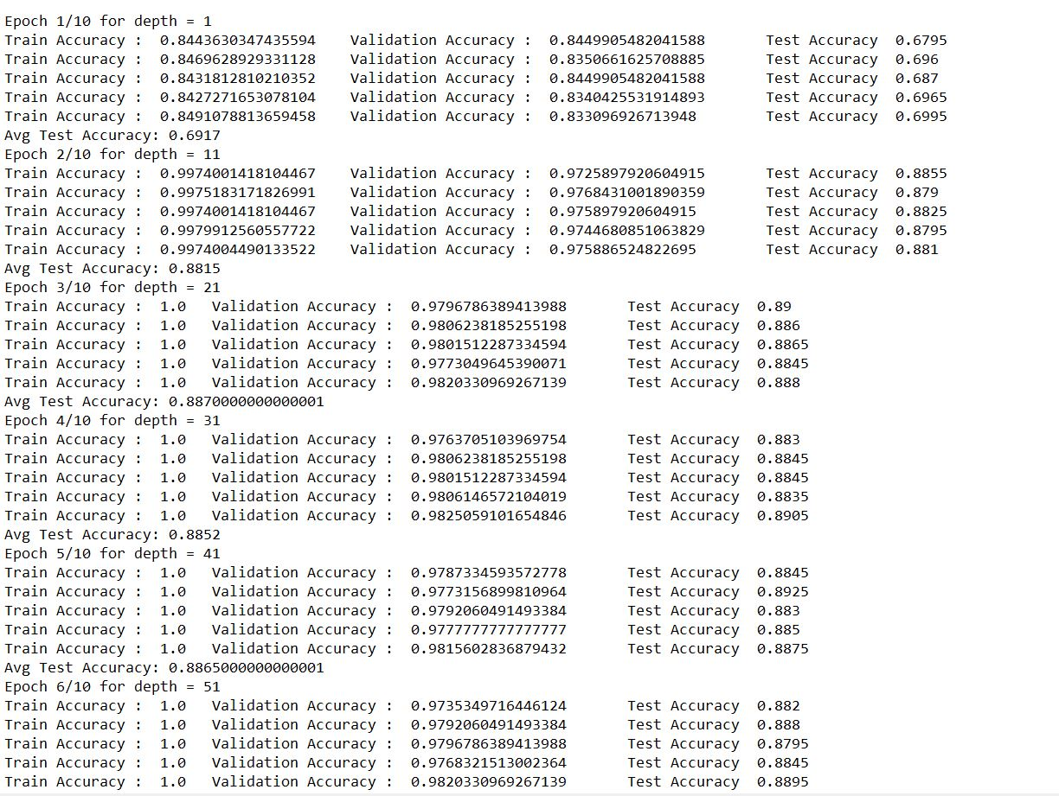

Slide 16
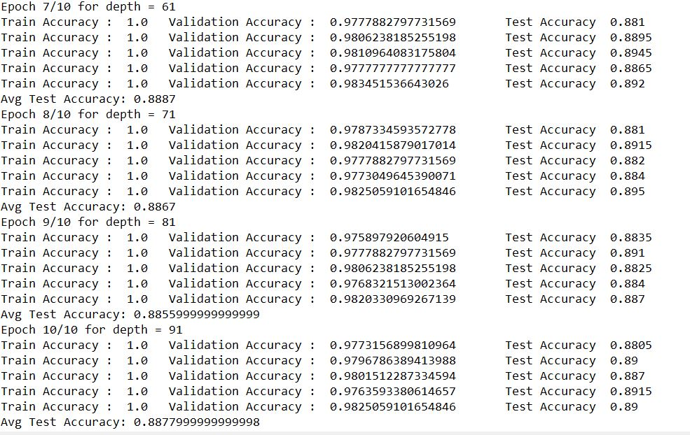

Slide 17
Random Forest for KMR-3 and pseKNc
Range 1-500

Slide 18
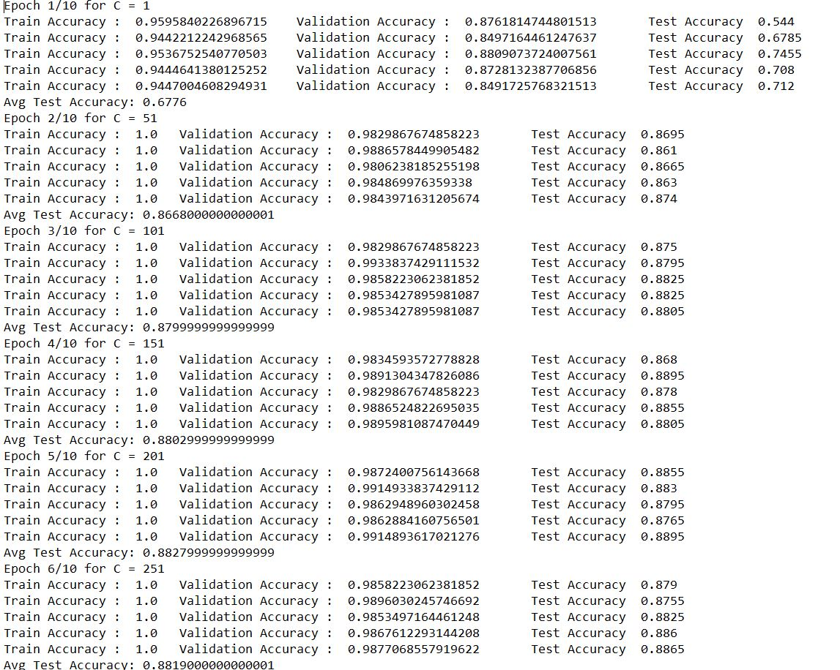

Slide 19
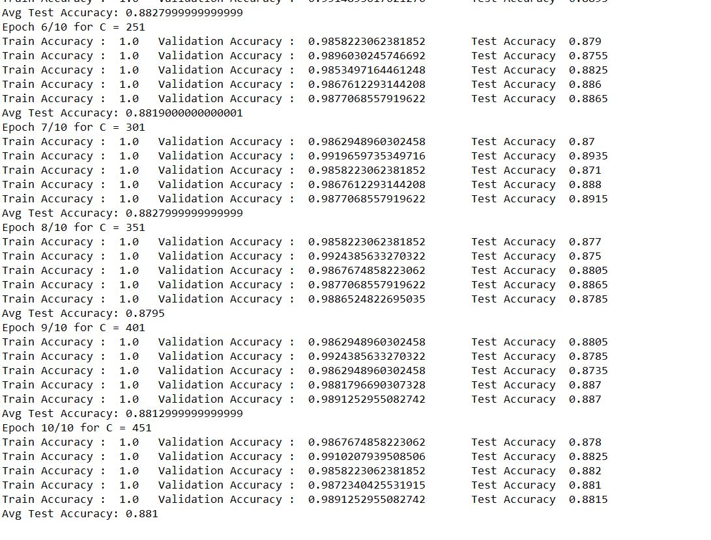

Slide 20
Range 245-255

Slide 21
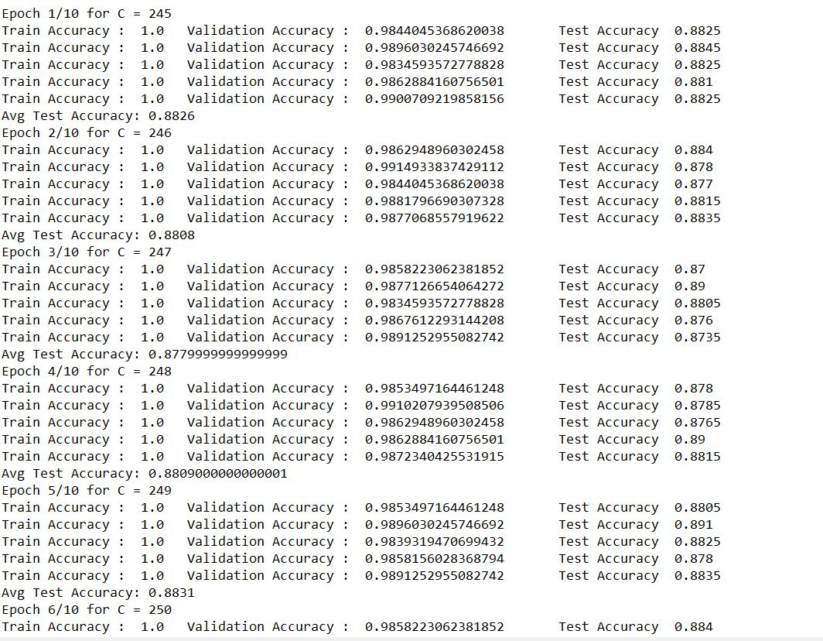

Slide 22
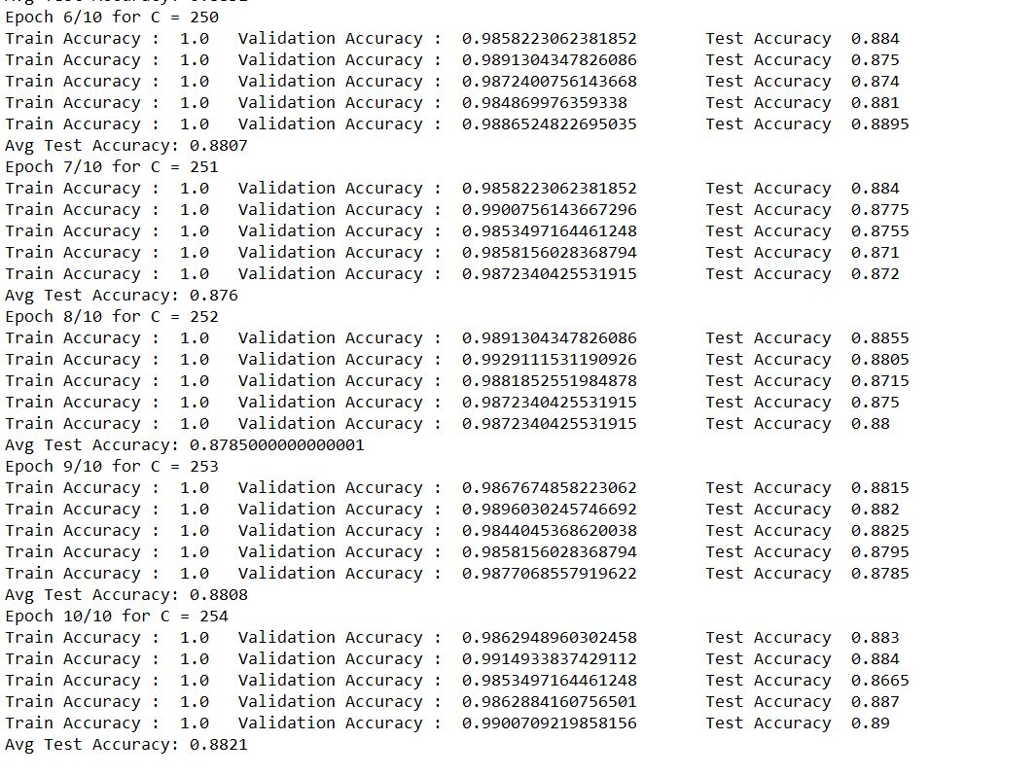

Slide 23
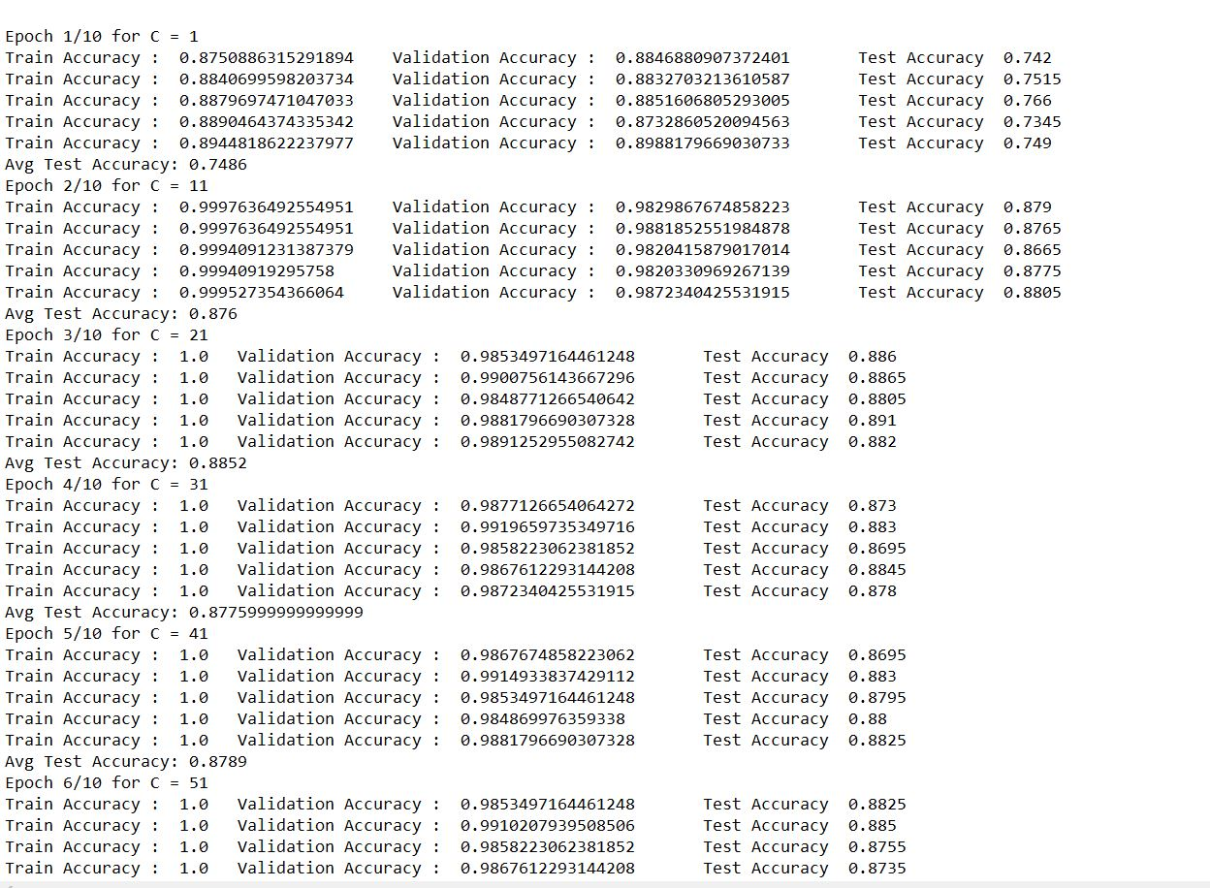

Slide 24
